Slide 1

Capstone Project - 2 Rainfall Prediction using machine learning

Slide 2
Problem statement:-
Limited accuracy and timelines of rainfall forecasts effective planning and management of agricultural activities, water resources, and disaster response.
Developing a machine learning model to predict rainfall patterns accurately and in advance.
Initially, the focus will be on predicting rainfall at specific locations over varying time intervals.

Slide 3
Aim and objective:-
This project aims to develop a robust machine learning model for rainfall prediction to aid in proactive decision-making for agricultural planning, water resource management, and disaster preparedness.
By leveraging historical weather data and advanced machine learning techniques, the goal is to create a reliable predictive tool that can forecast rainfall patterns with high accuracy.

Slide 4
Scope of the Project
Data Collection:- Gather historical weather data from reliable meteorological sources and preprocess it for model training.
Feature Engineering:- Extract relevant features from the collected data, including temporal patterns, geographic characteristics, and atmospheric conditions.
Model Development:- Utilize machine learning algorithms such as Random Forest, Gradient Boosting, or Long Short-Term Memory (LSTM) networks to train predictive models.
Model Evaluation:- Assess model performance using metrics such as accuracy, precision, recall, etc.

Slide 5
Data preprocessing:-
The Purpose of preprocessing involves cleaning and transforming raw data into a format that can be effectively used for machine learning. The goal is to make the data suitable for the model by handling missing values, scaling features, encoding categorical variables, and addressing other issues.
Some Key inferences after performing preprocessing:-
The dataset consists of 23 fields and 145,461 records, including integer and object data types. The 'objects' need to be converted into integers for further modeling.
The dataset is free of duplicate values and special characters.
However, it does contain null values, since the missing (null) values constitute less than 1%, we can drop them using dropna(). But it's important to note that some of these missing values may contribute to a default value of 1, indicating that these records show loan defaults. Therefore, we'll use fillna() to impute these missing values by employing the mode and median aggregation.
Next, we will utilize Label Encoder to convert categorical variables into numerical ones.
Following this, we'll split the data into independent (X) and dependent (y) variables. Subsequently, we'll scale the independent variables (X) using Standard Scaler.
Lastly, we will divide these variables into training and testing sets to facilitate further model building

Slide 6
EDA- exploratory data analysis
The Purpose of EDA is for analyzing and visualizing data to understand its key characteristics, patterns, and relationships. The goal is to gain insights into the data distribution, identify potential outliers, and understand the relationships between variables.
EDA involves creating visualizations (histograms, scatter plots, etc.) to explore the distribution of individual features, relationships between features, and potential patterns in the data
EDA is typically performed after data preprocessing and before building machine learning models. It helps in understanding the data, selecting relevant features, and guiding subsequent modeling decisions.
Mostly we’ll deal with Univariate and Bivariate analysis.

Slide 7
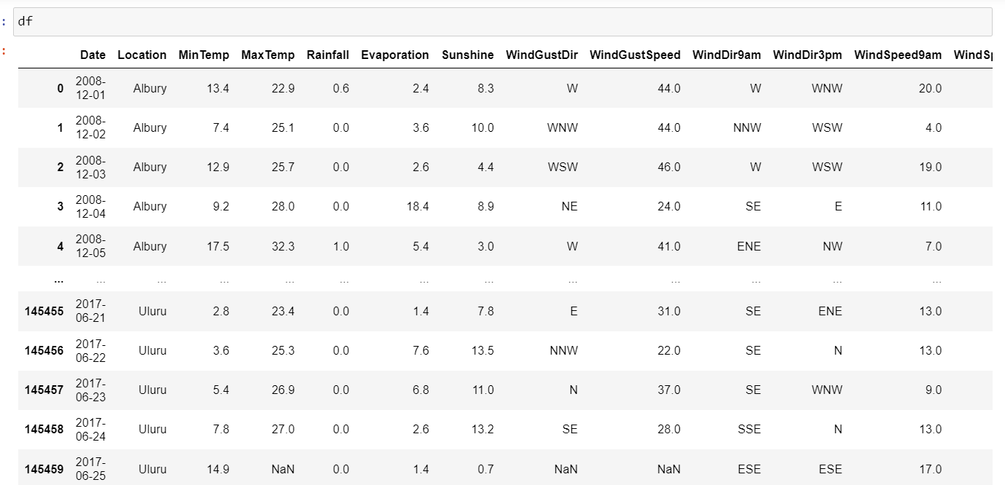
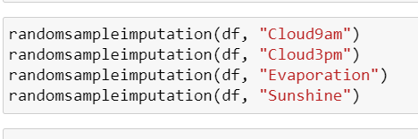
Using random sampling:-
Random sampling imputation is a technique used to fill in missing values in a dataset by randomly selecting values from the non-missing observations within the same variable. This approach is commonly employed when the missing data is assumed to be missing at random, meaning that the missingness is unrelated to the values of the variables themselves.
we choose random sampling for the following reasons:- Preservation of Variability: Random sampling maintains variability by selecting values from observed data, thus preserving statistical properties.
Simple Implementation: Straightforward, suitable for large datasets, simplifying the imputation process.
Flexibility: Allows customized sampling based on specific criteria, enhancing adaptability in handling missing values.

Slide 8
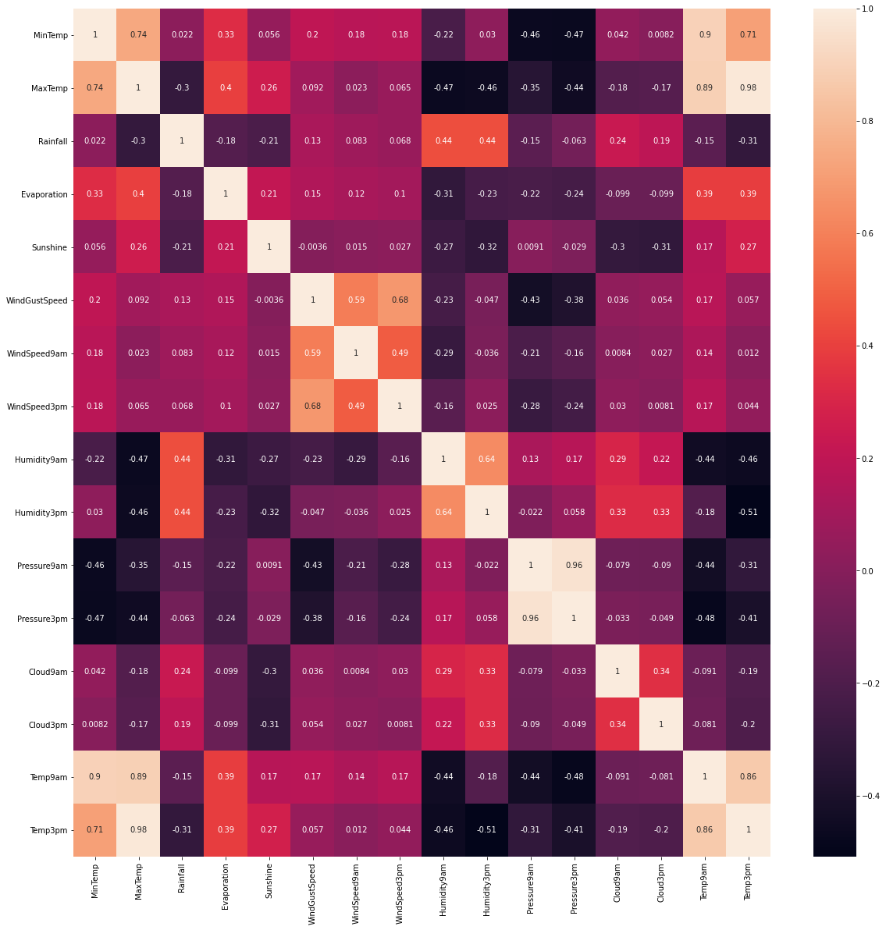
Feature Engineering:-
Checking for Multicollinearity between independent (predictor) variables using heat map.
Multicollinearity is a statistical concept that occurs when two or more independent variables in a model are highly correlated with each other. It indicates a strong linear relationship among the predictor variables
Heatmaps are visual representations of data in a matrix format, where colors represent values. In the context of multicollinearity, heatmaps are often used to display the correlation matrix of independent variables.

Slide 9
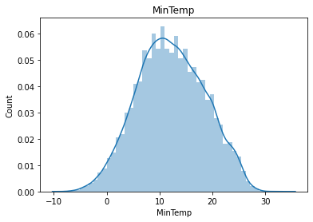
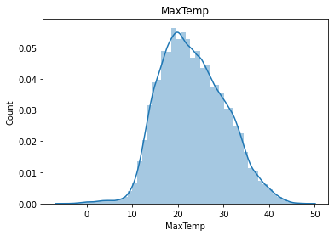
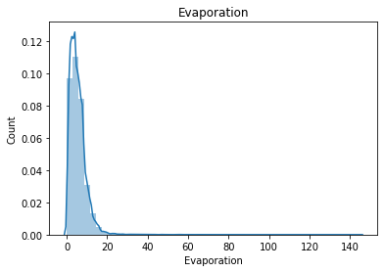
Visualizing distribution using distplot
Distplot is particularly useful for visualizing distribution of continuous variables.
It helps in understanding the shape,spread and central tendency of data.
Here are the various graphs for normal distribution.

Slide 10
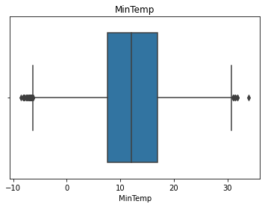
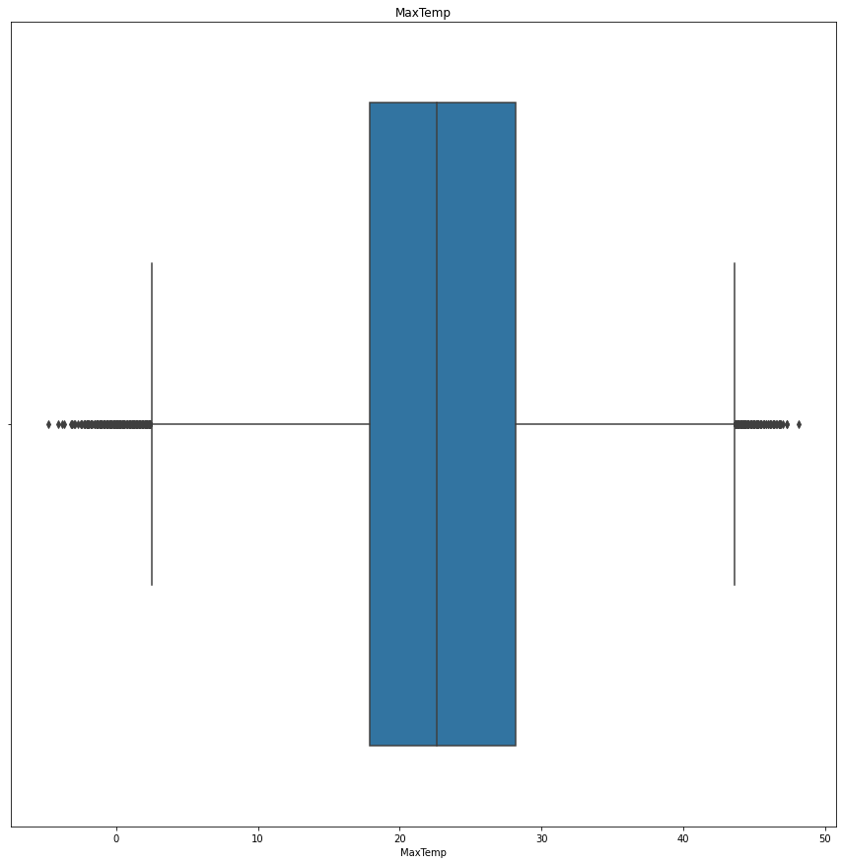
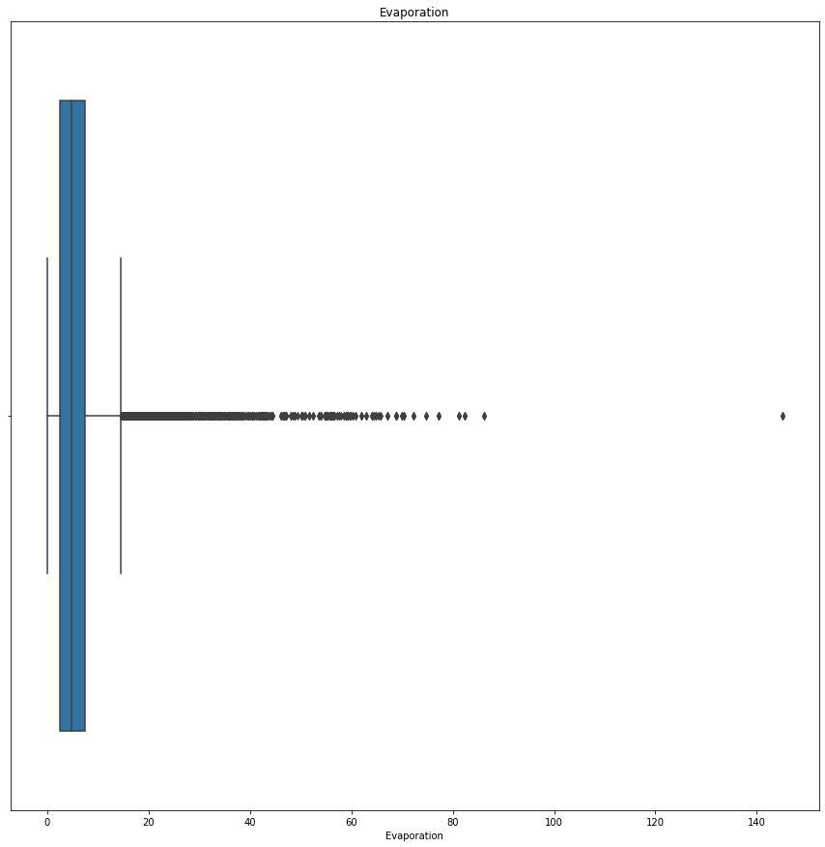
Checking for outliers using boxplot
Outliers are anomalies within a dataset, representing data points that deviate significantly from the majority. They can be either much larger or significantly smaller than other values
Outliers may arise due to measurement errors, experimental variability, or genuine anomalies in the data.

Slide 11
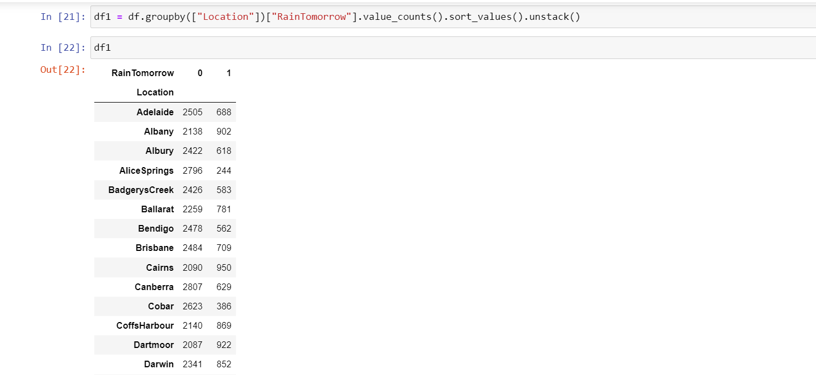
Using categorical feature by groupby
Categorical Grouping: The groupby operation is used to group the DataFrame df by the categorical feature specified in the loop (feature). This means that the data will be divided into groups based on unique values of the categorical feature.
Insights gained from the grouped data can aid decision-making processes. For example, if certain categories consistently have a high average likelihood of rain, it might inform decisions related to resource allocation, planning, or risk management.

Slide 12
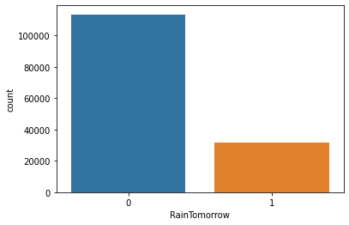
Visualization of categorical data
Countplot is used to visualize the counts of observations in each category of a categorical variable. In this case, it's plotting the count of occurrences of the "RainTomorrow" variable, which appears to be a categorical variable indicating whether it will rain tomorrow or not.
Count plots provide a simple yet effective way to communicate insights about categorical variables. They are often included in reports, presentations, or dashboards to convey information about the distribution of categories to stakeholders.

Slide 13
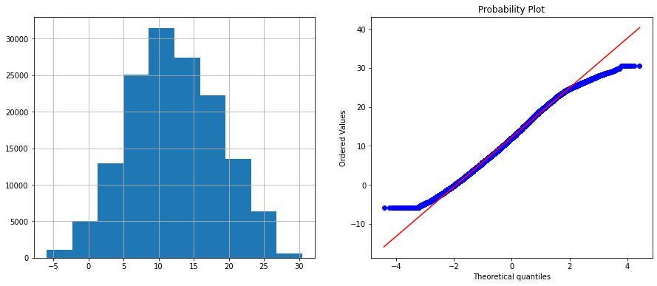
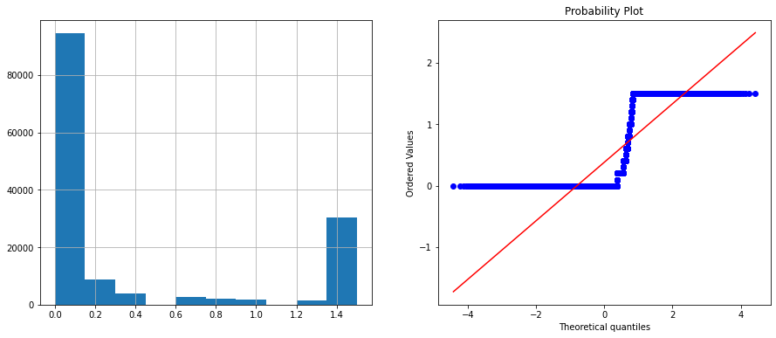
Getting out probablilitys
Iterating Over Continuous Features: The loop iterates over each continuous feature in the dataset, implying that the analysis is conducted individually for each continuous variable.
Using subplotdivides the plotting area into two subplots horizontally. This arrangement allows for side-by-side comparison of the histogram

Slide 14
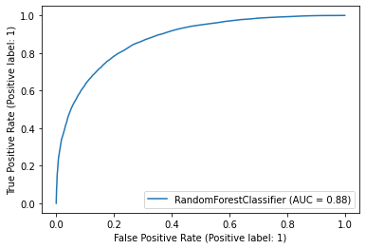
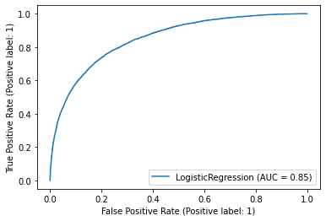
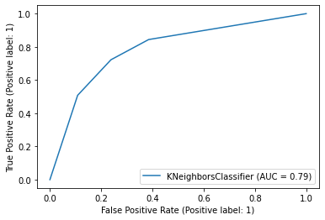
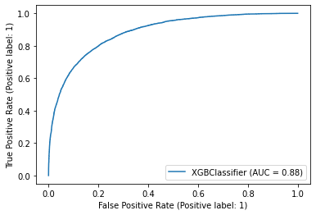
Using different models
Model Evaluation: Evaluate the performance of both models using appropriate metrics such as accuracy, precision, recall, ROC AUC score, etc. Choose metrics that are suitable for your specific problem and consider the trade-offs between different evaluation criteria..

Slide 15
Top 5 insights from data pre processing
Feature Engineering for Enhanced Predictive Power: Careful selection and transformation of features improved model discernment of atmospheric conditions conducive to rainfall, enhancing predictive accuracy.
Data Quality Assurance: Rigorous checks were conducted to ensure data cleanliness, completeness, and consistency, minimizing the risk of biased conclusions.
Normalization and Standardization: Scaling features to a common range facilitated stable model training and convergence by standardizing feature distributions.
Handling Imbalanced Data: Techniques like oversampling and under sampling addressed class imbalance, preventing model bias and enhancing generalization.
Feature Selection for Dimensionality Reduction: Selecting the most informative features reduced computational complexity, improved model interpretability, and mitigated overfitting risks.

Slide 16
Why this project is useful
Agricultural Sector: Accurate rainfall forecasts aid farmers in optimizing irrigation schedules, crop planting, and harvesting, thereby increasing agricultural productivity and minimizing water usage.
Water Resource Management: Precise predictions assist in managing reservoir levels, water distribution, and drought response strategies, ensuring efficient utilization of water resources and mitigating the impact of water scarcity.
Disaster Preparedness: Early detection of potential rainfall anomalies enables proactive measures to be taken, such as flood prevention, evacuation planning, and infrastructure reinforcement, reducing the vulnerability of communities to weather-related disasters.
Infrastructure Planning: Reliable rainfall forecasts inform urban planning initiatives, construction projects, and drainage system designs, enhancing resilience against flooding and minimizing infrastructure damage risks.
Environmental Conservation: Timely rainfall predictions support conservation efforts by facilitating habitat restoration, wildlife management, and ecosystem preservation activities, promoting biodiversity and ecological sustainability.

Slide 17
Conclusion
In conclusion, our rainfall prediction project has yielded promising results, marked by a robust Area Under the Curve (AUC) score.
Through meticulous data preprocessing, feature engineering, and model selection, we have developed a predictive model capable of effectively discerning patterns in atmospheric conditions to forecast rainfall accurately.
Overall, the attainment of a commendable AUC score underscores the efficacy of our approach in rainfall prediction, underscoring its relevance and applicability in addressing real-world challenges associated with weather forecasting.

